Slide 1
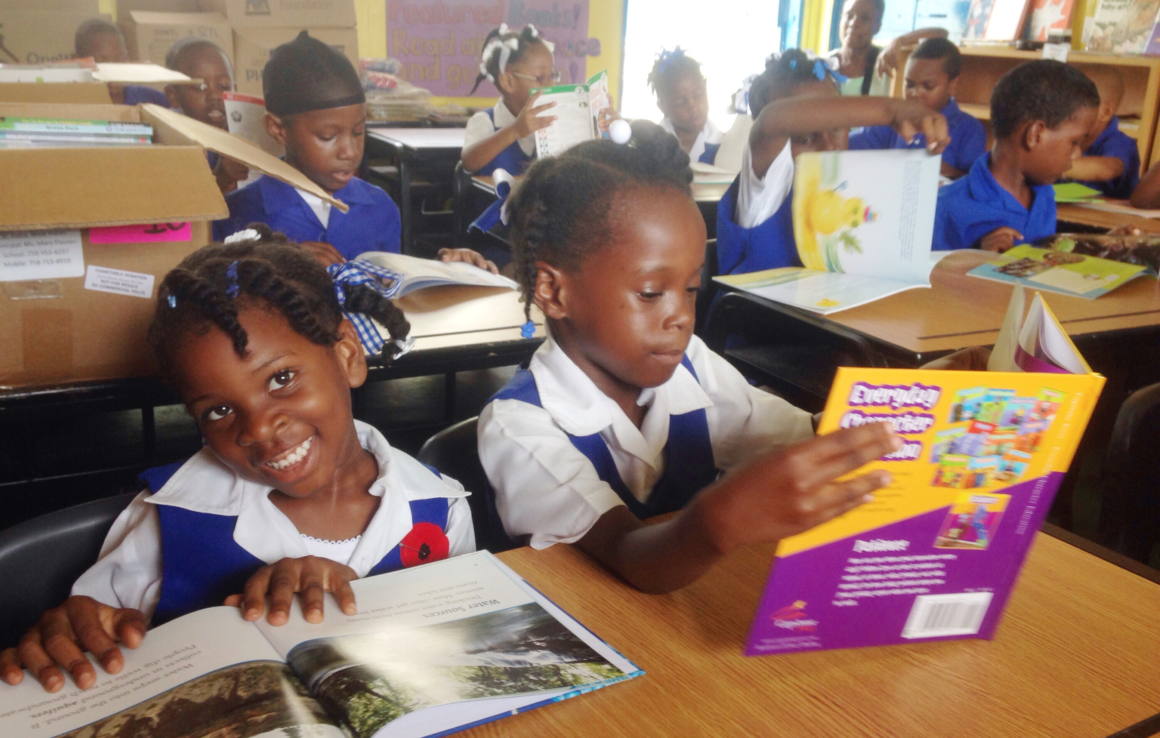
Reading Workshop Ideas and How to Build a Community of Lifelong Readers
Notes:
In this video, we will be talking through reading workshop ideas and how to build a community of lifelong readers.

Slide 2

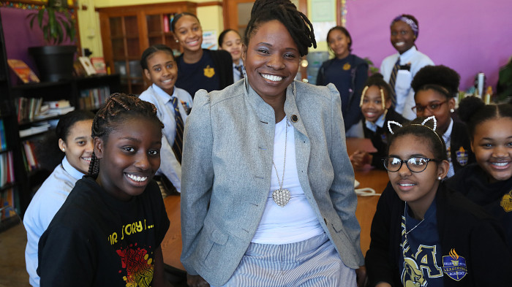
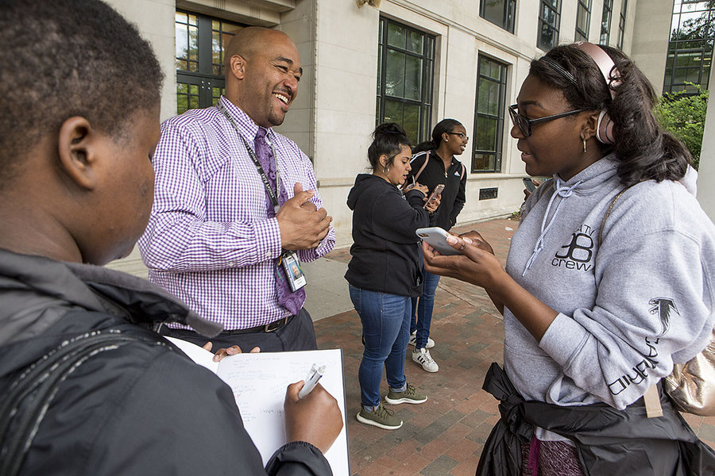

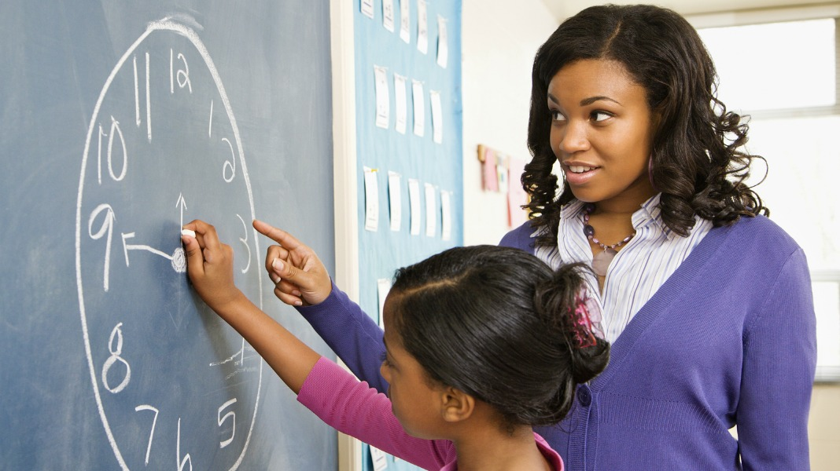
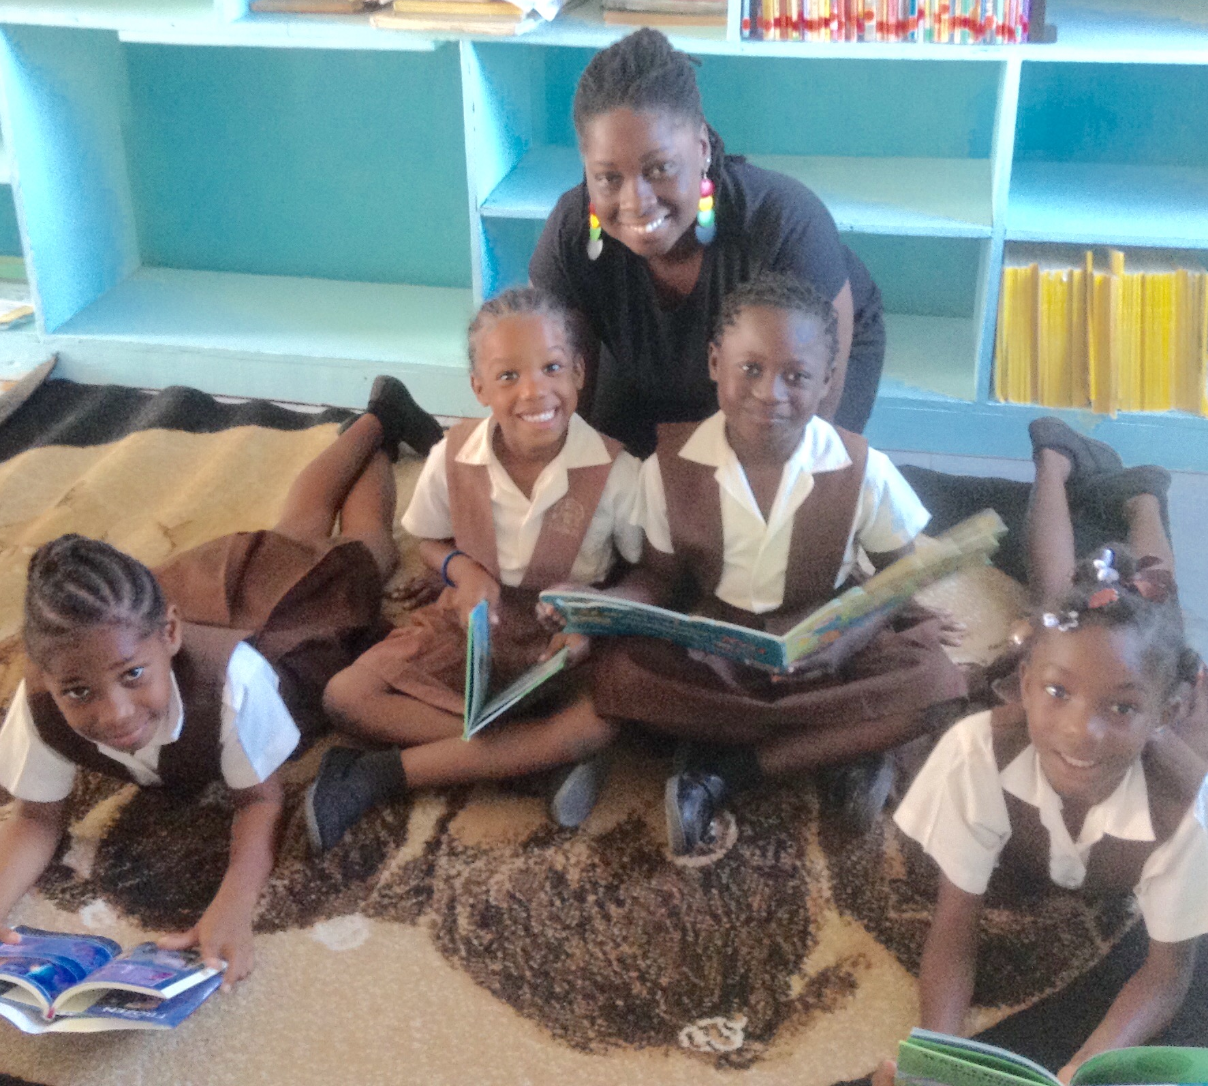


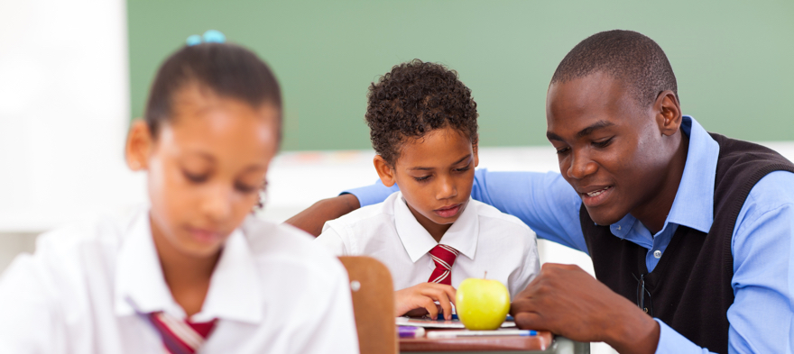

Who was your favorite teacher in school?
Notes:
Who was your favorite teacher in school?
For me it was my *algebra teacher. And let me preface this by saying, I didn’t like math growing up, so the class itself was really hard for me. *But the teacher made the difference. Mrs. Alsopp cared about me. *She wanted me to succeed.
You want to know how I KNEW that as her student--a young 15 year old girl? *She got to know me. She asked me questions about myself. *She talked to me outside of the lesson and class time. She wanted to know who I was, what was interesting to me, what I liked to do, what I wanted to be when I grew up. *This wasn’t a one time thing. She was consistent to talk with me like I was an intelligent person (not just a little child). She believed in me. She knew I could do the math even before I believed I could. You know how? *She reminded me of what I was able to do well—in the midst of my frustration. And she kept telling me that if I had been successful THEN, I would be successful now—if I kept trying, practicing, asking questions.
*I respected Mrs. Alsopp, but I wasn’t afraid of her—and that allowed me the emotional safety in her classroom to work hard, not freak out about making mistakes, and feeling good about myself in the process of learning new things that were somewhat intimidating to me.

Slide 3

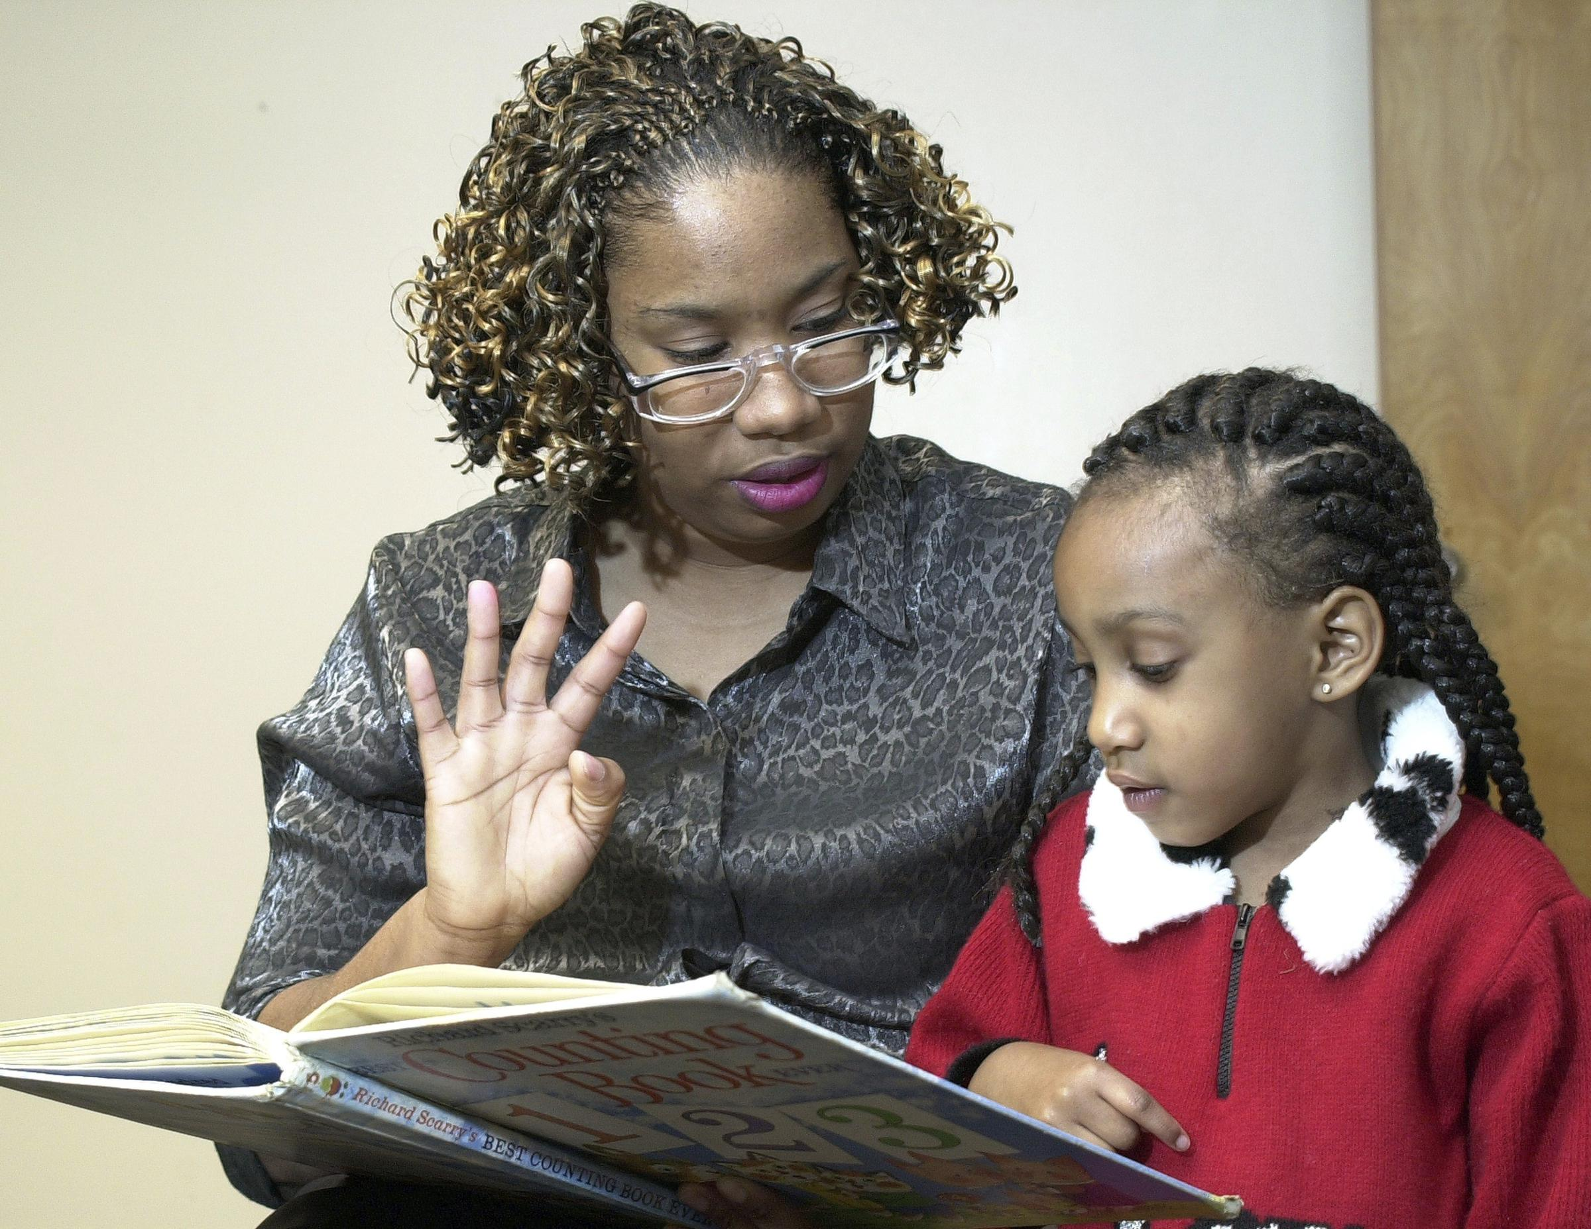
Make connection with our students
Notes:
The same is true for your students. They are desperate for connection.
*Teaching is all about making connections with our students.

Slide 4
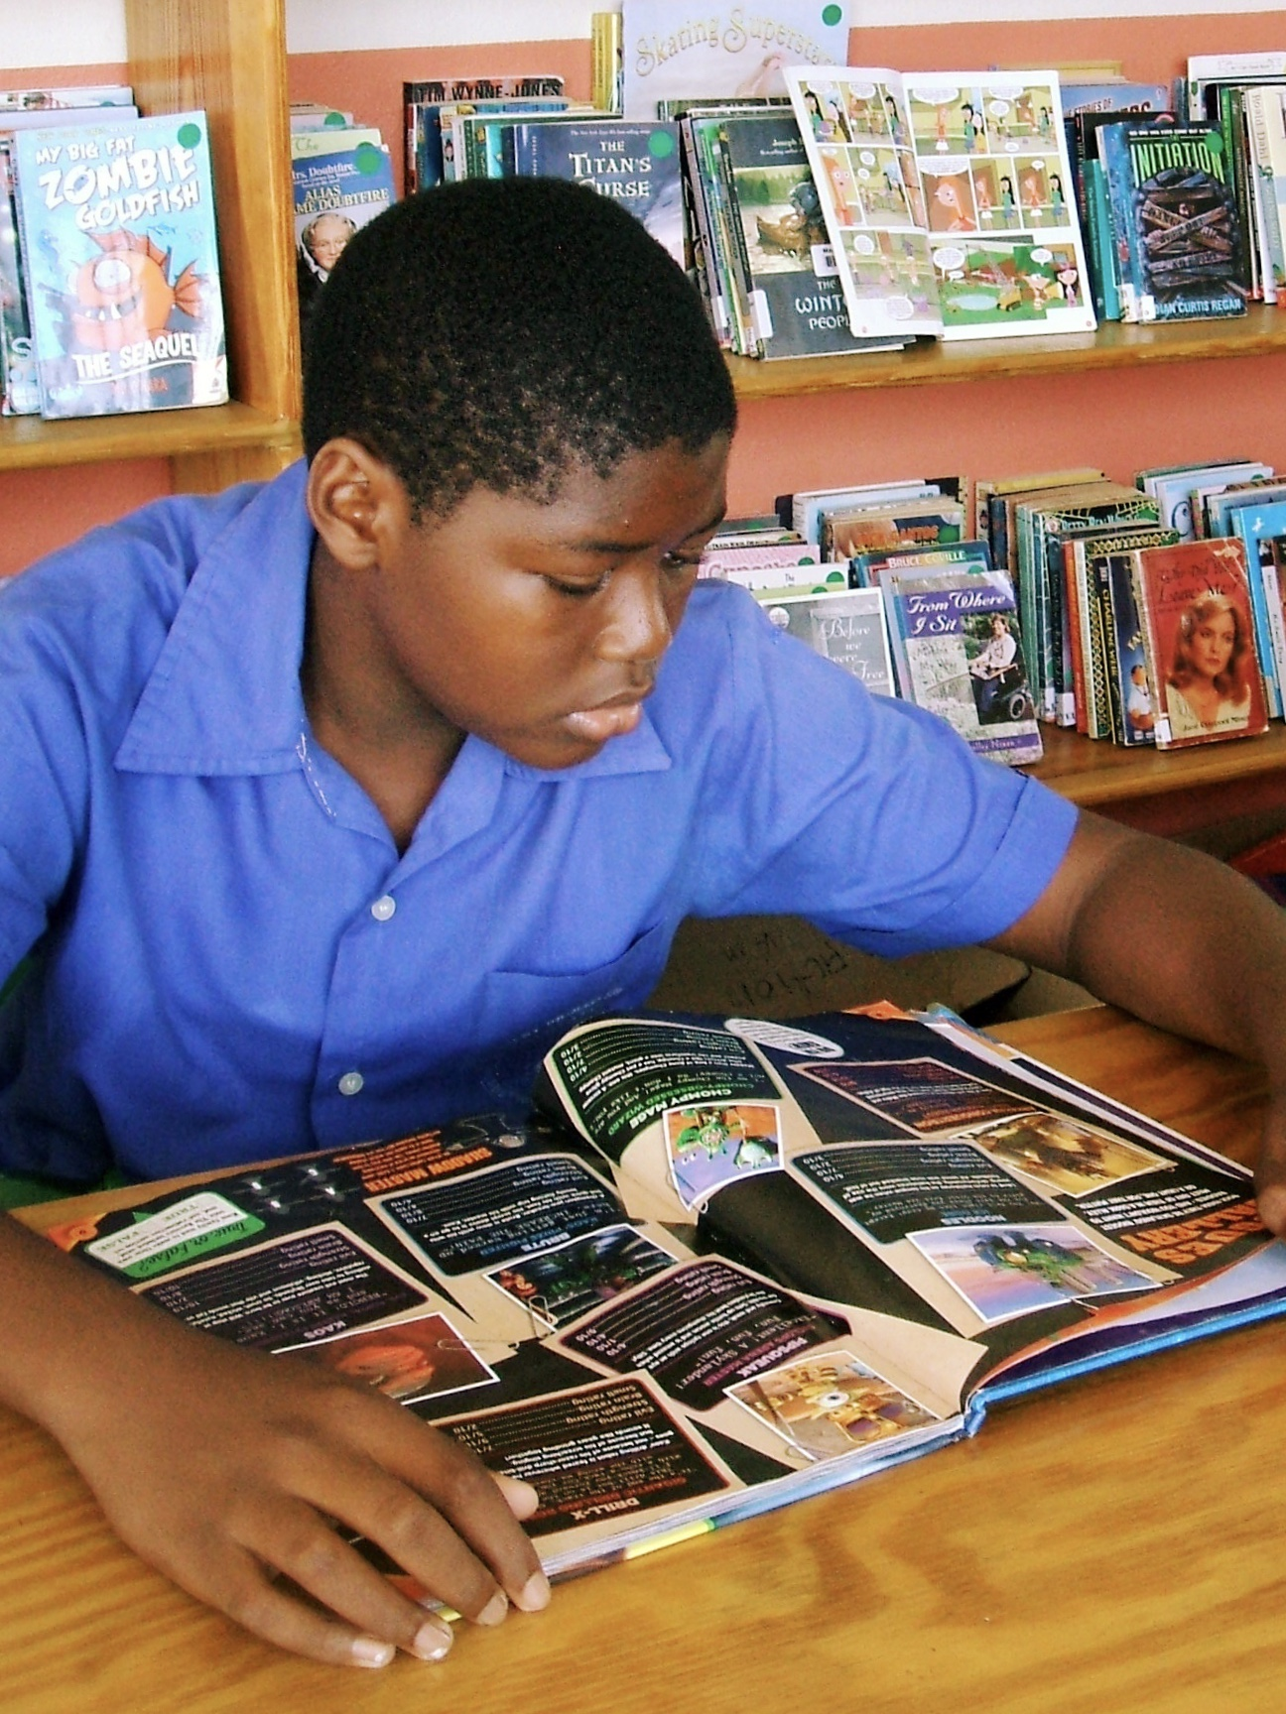
Think about:
Who are the children in your school?
How can you start to form relationships with them?
How will forming relationships with the students make teaching and learning easier?
Notes:
I want you to think about these questions. Maybe even close your eyes and visualize in your mind while I lead you through this series of questions--
**Who are the children in your school? What town or towns are they from? What kinds of homes are they from? What do they like to play? What subjects do they enjoy talking about?
*Think of one child in your class in particular. I want you to pick a student who struggles with reading or who doesn’t like reading. Who is he or she? What do you know about him or her? What does this child like to do? What does this child like to talk about? What does this child want to be when he or she grows up? Does this child have any strengths? What are those skills he or she is good at? Have you told this child that you’ve noticed he or she has this skill and you like that about them?
2. *How can you start to form relationships with your students? Could you ask your students questions when walking into the classroom? Could you talk with your students to and from lunch? Could you chat with your students at the end of the day?
3. *How will forming relationships with the students make teaching and learning easier? Who are the people in your life that you trust the most? Do they care about you? Is trusting them easier because you know how much they care about you? How can you develop more trust with your students over the course of the year?

Slide 5
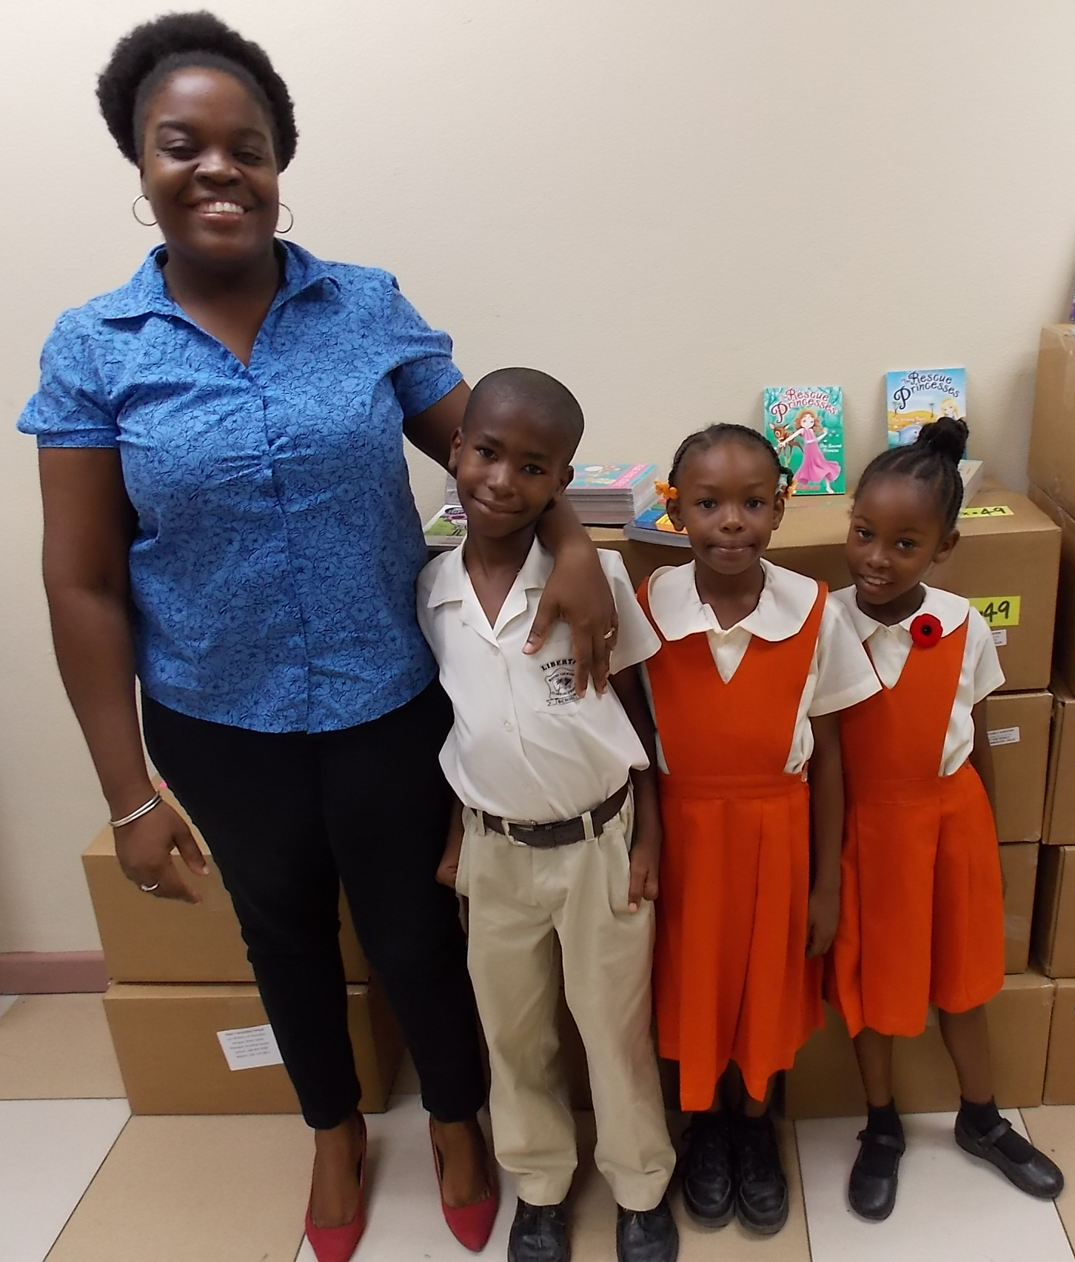
Build relationships first and the learning will come easier.
Notes:
What I have found from personal experience and from drawing on the experience of other well-respected educators whose students have gone on to see huge success is that building relationships with our students is the key to learning.
When we make building relationships with our students a priority, the learning will come easier to them, because they trust us that much more.

Slide 6
Build relationships first and the learning will come easier.
Classroom management
Rapport
Respect
Trust
Listen!
Notes:
*Classroom management improves when teachers have taken the time to build *rapport with their students. When teachers listen to their students and really take the time to learn about who they are as individuals, students begin to *respect their teachers so much more. Respect—not out of fear—but out of *trust.
If there’s only one take-away from this, let it be this--*listen. Stop talking at your students. Listen. Hear what they are saying. Ask them questions and just wait. Let them tell you who they are. Students want to be cared about. Even the older ones who act like they’re too cool for us. They want to feel like they belong. And you can make that happen.

Slide 7
Goal: Lifelong readers!
Notes:
Our goal at Hands Across the Sea is to empower you as teachers to go back to your classrooms and create lifelong readers out of your students! We want students to be excited about books! We want students to be eager to find their next book on the shelf. We want your students to be hungry to get through the pages of their book at home and at school. We want your students to WANT to read for themselves!

Slide 8
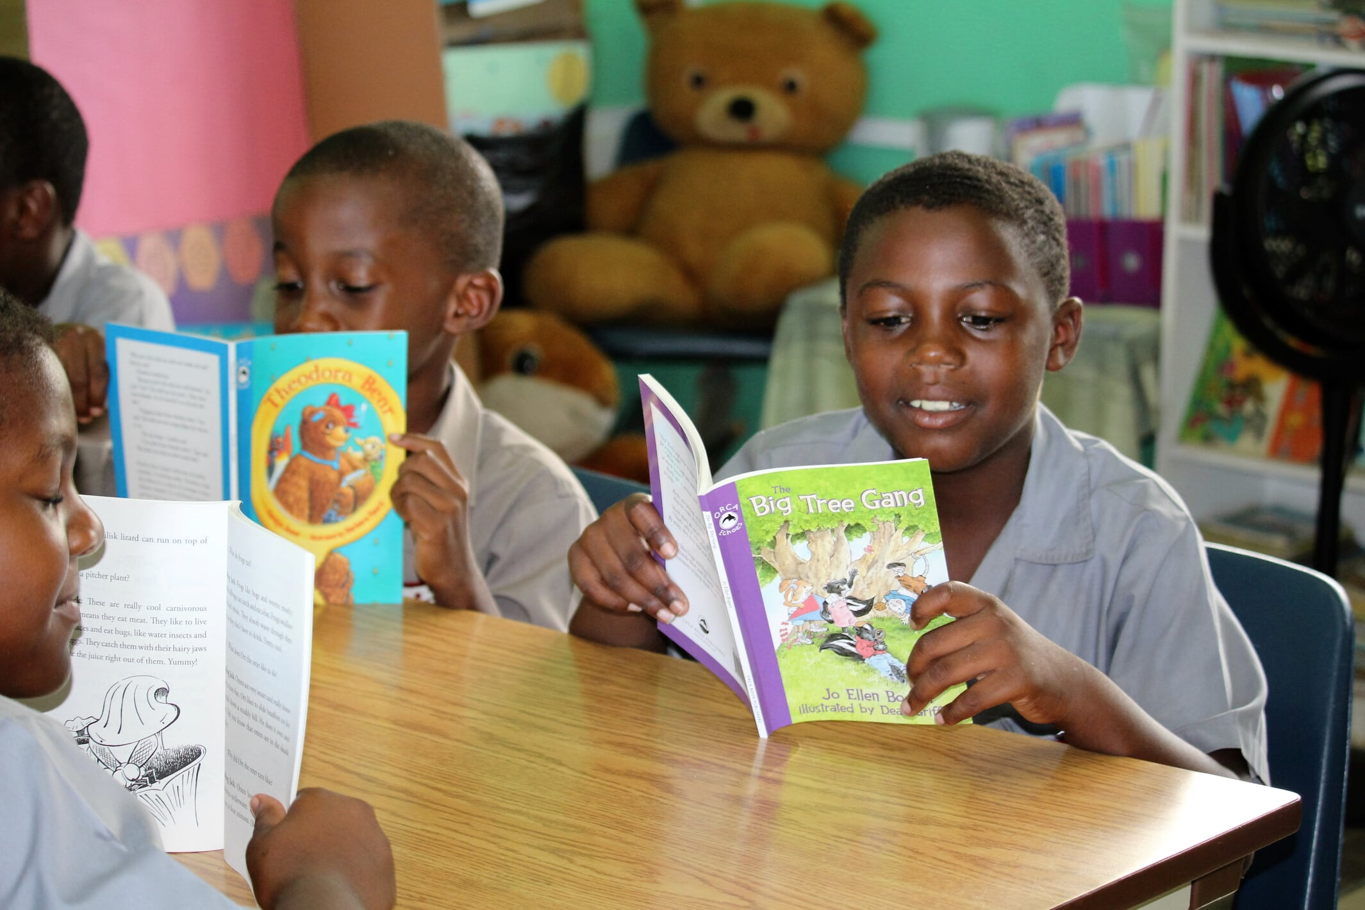
What gets kids to love reading?
TIP: Get your students to talk about books!
Notes:
So what gets kids to love reading?
What got YOU to love reading? Pause the video and discuss as a group a few ways that you have observed through your experience as a teacher—what gets students to love reading?
When you are finished discussing, resume the video.
*One tip is to get your students to talk about books. Many students don’t even know that books about topics they like and enjoy are actually on the shelves in their library! The more we talk about the books that are in the library, the more aware our students are of what is available to them.

Slide 9
Building a Community of Lifelong Readers
Set aside time to read for yourself and for your students.
Talk and turn: What can you do to model reading to your students?
Notes:
Building a community of lifelong readers starts with you.
You have the power to create the environment that fosters this kind of reading growth for your students.
Set aside time to read for yourself and for your students.
Do you see yourself as a reader? Are you in the middle of a book right now? Why not?
If it is because you are about to tell me that you don’t have time, I am going to stop you right there. You have the power to set aside time IN YOUR CLASSROOM during your school day to read for yourself.
When it is reading time, everyone—including you, the teacher—pulls out the book that they’re reading, and reads. Model reading for your students. Carry a book in your bag. Bring it to school. Bring it home. Read it at school. Read it on the bus during your commute to and from work everyday. Yes, read chapter books. Adult books are great, but so are the books in your school’s library. I learned so much about myself as a reader at the age of 29 when I started reading books that I wanted my own students to read too. I read books geared toward Grad 4 students-–and I loved them. It also gave me the opportunity to talk with my Grade 4 students about the book I was reading and recommend it to them to read next. They were so excited to get a hold of the copy of my book once I finished it, because they knew how much I enjoyed reading it—and they wanted to talk with me about it and find out for themselves if they liked it too!
You can read picture books too! It’s ok to go to your school’s library and check out books for yourself to bring home and read aloud to your own children in the evenings. This is an amazing way to practice read-alouds. Start with your kids! How do they respond to the book? Did they like it? Do they think Momma should use it to teach with?
Can you imagine what this will do for your own children and their pursuit of lifelong reading? It may take time getting into the routine, for children to know the expectations of you reading aloud at home to them—especially if you have never done it before. But once you start and stay consistent with it, I guarantee your own children are going to LOVE evening story time with you as their parent. Listening to books is part of building a community of lifelong readers too!

Slide 10
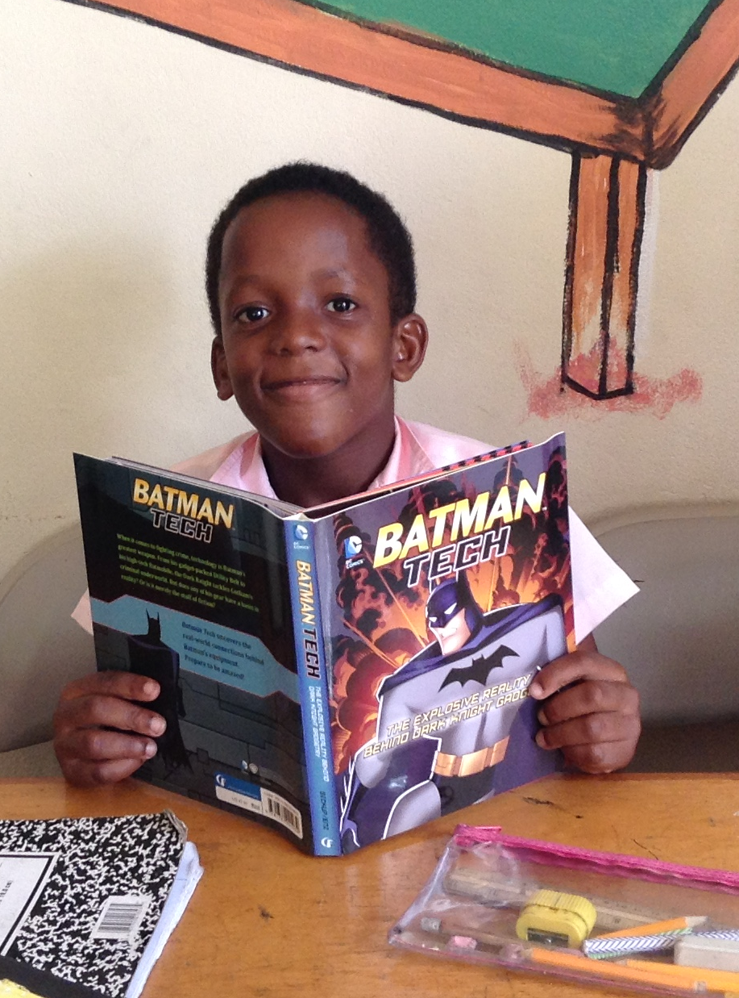
Building a Community of Lifelong Readers
2. Students should have choice in what they want to read.
Notes:
Students should have choice in what they want to read.
There are so many titles that Hands Across the Sea has sent over the years with children’s interests in mind. Our hope is that students will find books that excite them, because that in and of itself is a huge MOTIVATOR for them to read.
Reading should be enjoyable to students, because when it is—they will want to do it more. One way that we as teachers can make reading time more enjoyable for our students is to let them pick out the books that they want to read.
Yes, we want to expose our students to the classics—but at what expense? Our students need to build up the stamina and enthusiasm for reading first, before we introduce challenging books that require a lot more reading strength and endurance to read, understand, and enjoy.
So how do we gear our students to choose books on their own that are on their reading level?
Hands Across the Sea recommends school libraries to organize their book collections by grade level groups with a simple color-code system to help students in finding books that they can read and choosing books that are best for them.

Slide 11
Large font, few words, lots of pictures.
Level 1 - Yellow | Grade K and Grade 1
Notes:
*For Grade K and Grade 1, books are colored with a yellow dot on the binding and are kept on the shelves with the other *yellow dotted books. These are books that have large fonts, few words, and lots of pictures.

Slide 12
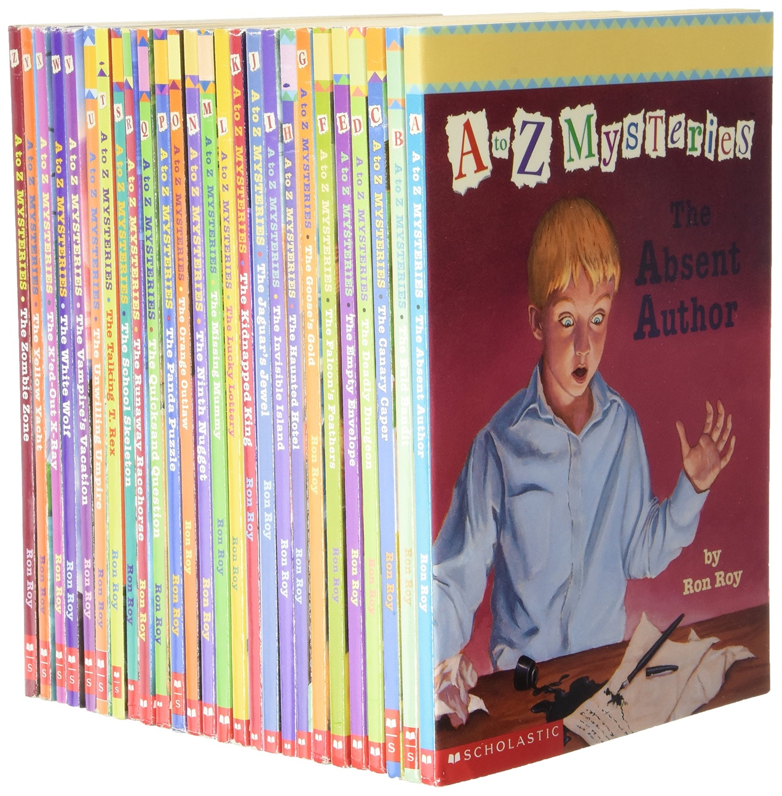
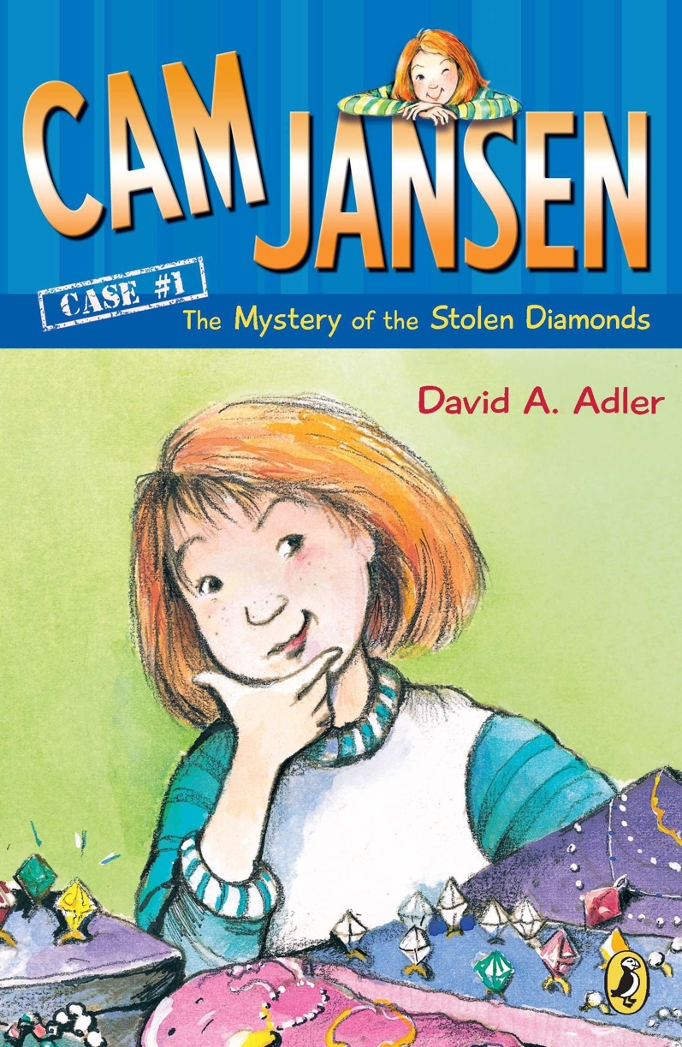
- Readers with a number 3, 4, or 5 on the cover. - Medium font size with fewer pictures. - Short, several-page chapters.
Level 2 - Blue | Grade 2, 3, and 4
Notes:
For Grades 2, 3, and 4, books are colored with a blue dot on the binding and are kept on the shelves with the other *blue dotted books. These are readers with a number 3, 4, or 5 on the cover, they have medium font size with fewer pictures, and short, several-page chapters. These are books like…
Blue-dotted books also include nonfiction books like short biographies on famous people, about animals, science, outer space, and social studies other concepts about topics that interest students but are on a lower reading level and are easier for students of this age group to read.

Slide 13
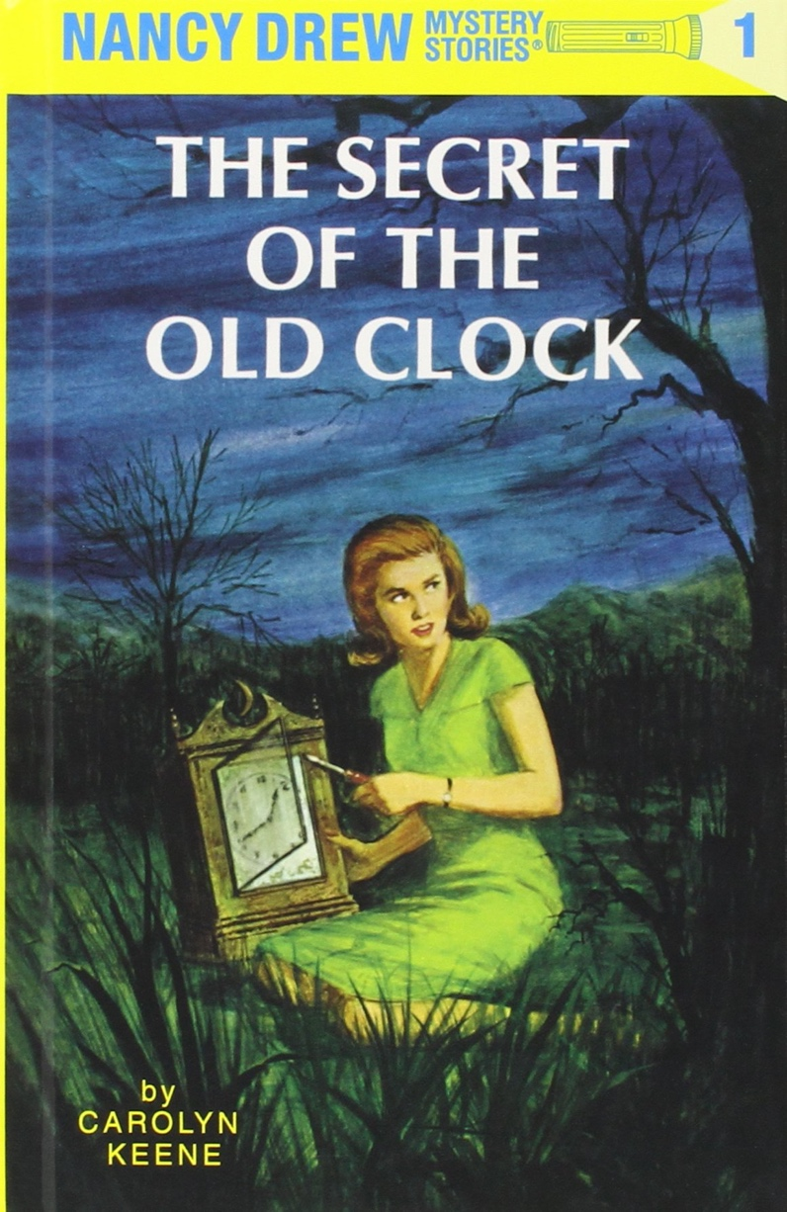
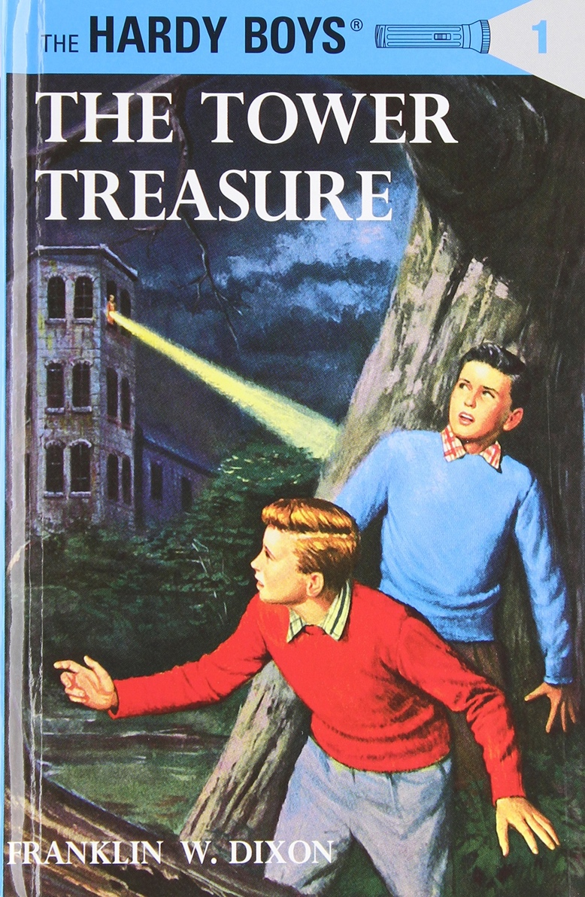
- Small font sizes with more advanced vocabulary - Fiction: few pictures -Nonfiction: text and pictures with detailed captions
Level 3 - Green | Grades 5 and 6
Notes:
For Grades 5 and 6, books are colored with a green dot on the binding and are kept on the shelves with the other *green dotted books. These books often have smaller font sizes with more advanced vocabulary. Fiction books often have fewer pictures or none at all. Nonfiction books include text and pictures with detailed captions.

Slide 14
- Encyclopedias - Dictionaries - Thesauruses - Atlases - Vintage Caribbean and West Indian titles (out of print)
Reference - Red | Dictionaries, atlases, etc.
Notes:
Books with a red dot are considered reference—but this only includes books like encyclopedias, dictionaries, thesauruses, atlases, and older vintage Caribbean and West Indian titles that may be out of print that are there for reference and safe-keeping.

Slide 15
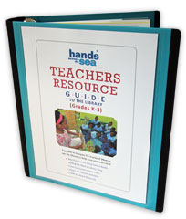
- Curriculum books - Teaching guides - Mature books - Charts, supplies
Teacher - Orange | Teacher’s Resource Guide, Big Books, etc.
Notes:
Your school may also have a section for orange-dotted books that are labeled so because they are for YOU the teacher. These include curriculum books, teaching guides, mature, adult books, teaching charts, and educational supplies that you can check out to borrow and use with your students in the classroom.

Slide 16
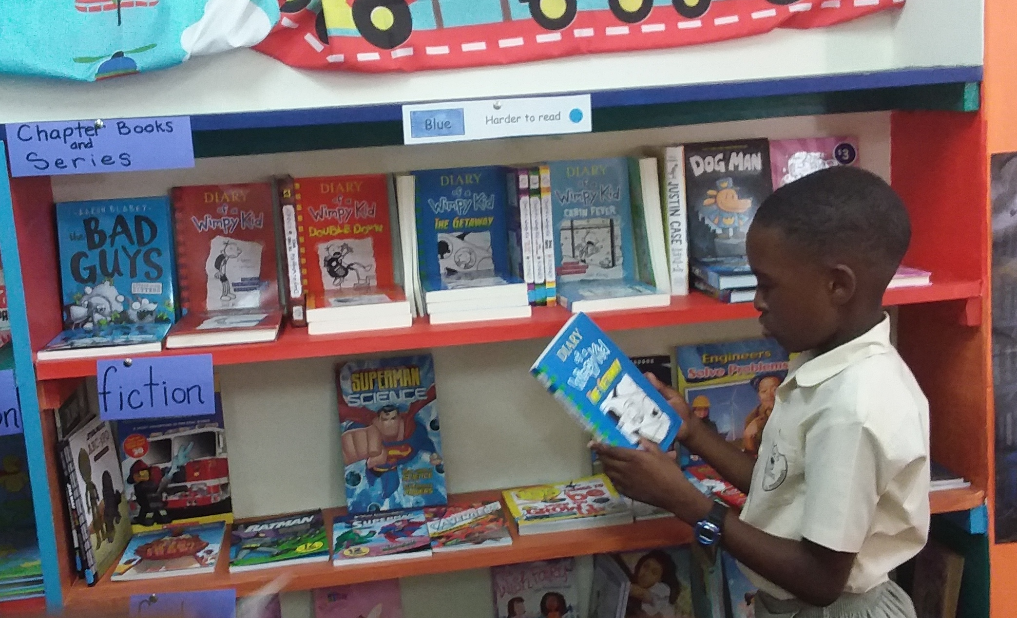
Be Flexible!
Encourage students to feel good about themselves as readers to motivate them to read more!
Notes:
*We all have students in our classrooms that are not reading at grade level. We also have students in our classrooms that are reading above grade level. We as teachers need to be flexible to support our students at where they are at.
Even though a child may be in Grade 5, he or she may not be reading on a Grade 5 reading level just yet. So encourage students to choose books that they CAN read—even if they may be labeled with a blue dot. Students in Grades 2-4 may need to choose books in the yellow section—because that’s where they are. The color-coding system is a generalization to help with finding books ABOUT on grade level, but there is nothing wrong with a child choosing a book that is lower or higher for him if that is TRULY where the student is at on his or her reading journey. We as teachers must encourage children to feel good about themselves as readers, and that may mean helping students find books that interest and excite them that may not always be in their grade level’s section.

Slide 17
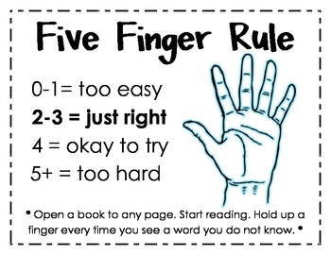
Choosing books on their own reading level
Notes:
*The Five Finger Rule is a simple way that students themselves can find just the right book. Teach this easy strategy to your class and then have them practice when you take them to the library to pick out a book to read!
Open a book to any page. The child begins to read the page. As the child reads the page to himself or herself, he or she holds up a finger every time they see a word that they do not know or cannot sound out. If the page has 0 to 1 words the student did not know, the book is probably too easy for them. If the book has 2-3 words they did not know, the book is probably JUST right for them to read. If the book has 4 words that the student did not know, then the book is ok to try—but may be difficult to read and frustrating. If the student sees five or more words that they did not know, then the book is most likely too hard for now—but the student could try it again in a few months or in the next year once he or she has read more books that are easier and just right!
Stamina is the key. Often students who do not read regularly, need to choose books that are just right for them to gain the reading stamina to read for longer periods of time. Sometimes starting with several short books is the best way to get students feeling confident enough to try harder, more challenging books. The Five Finger Rule empowers students to gauge their reading level and-–even though it is not a formal test, it helps students better understand where they are at!

Slide 18
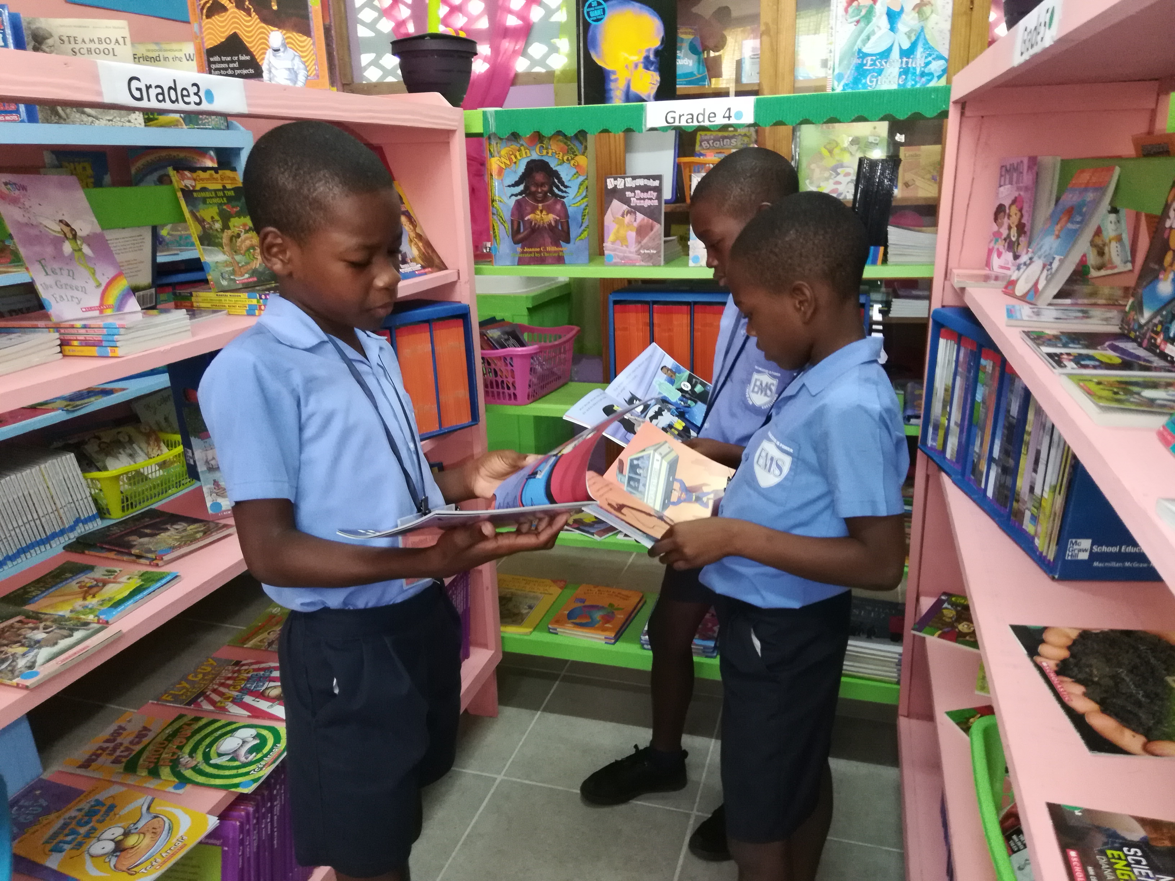

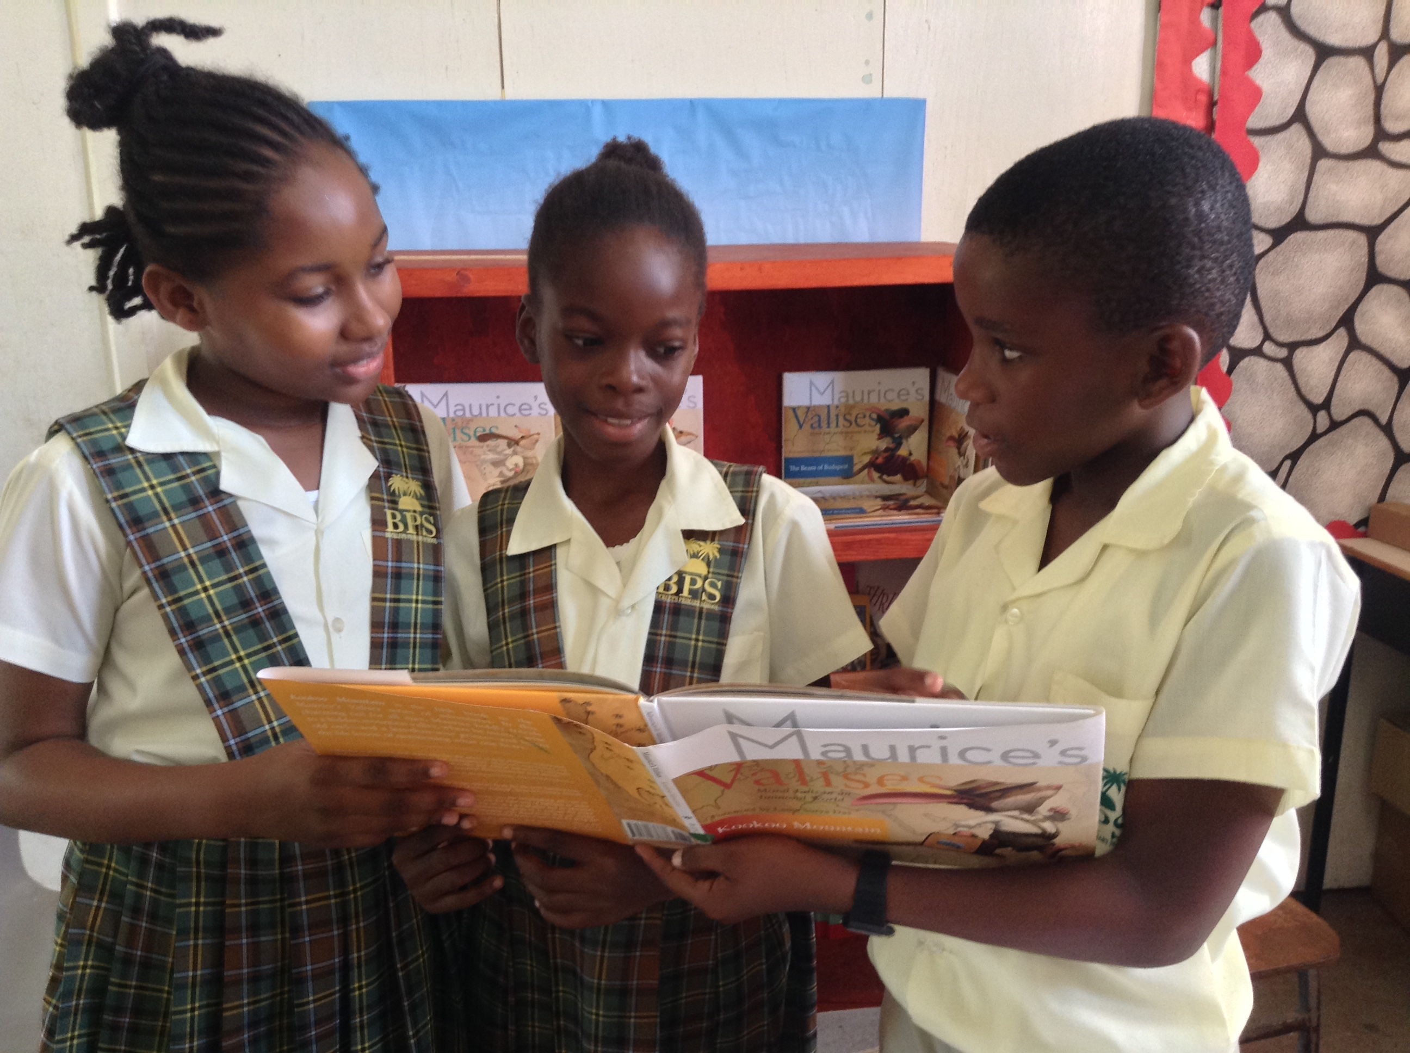
Building a Community of Lifelong Readers
Share books and reading with one another.
Notes:
Another extremely important factor to building a community of lifelong readers is sharing books and reading with one another. Lifelong readers talk about the books that they are reading and share books that they love with other avid readers. *Book clubs and discussion around books is so important. Buddy reading and investigating books together is another way that encourages conversation about books among students.
Do you share the books that you are reading with your students? Even just starting class with a few simple sentences like, “Good morning class, I just brought home the *book Maurice’s Valises: Micetro of Moscow to read to my children last night. We really enjoyed it together. It’s about a mouse who helps a musician complete the music piece that he is writing for the ballet. It’s got pictures throughout, and the ending is the best part—you’ll have to read it to find out. It’s available in the library for you to check out.”

